Slide 1
Real Time Protocol
-0209 Sumit Shrestha

Slide 2
Introduction
IP that manages real-time transmission of data.
Unicast (HTTP) or Multicast networks.
Used in communication, entertainment systems (streaming media) like TV, Video conference.
Runs in UDP Protocol.

Slide 3
RTCP
Monitor data delivery for multicast networks.
Receiver to detect if there is packet loss and delay jitter.

Slide 4
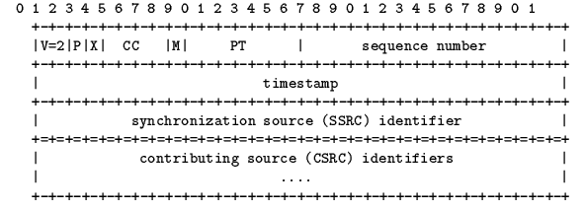
RTP Packet Format

Slide 5
THANK YOU

